Slide 1
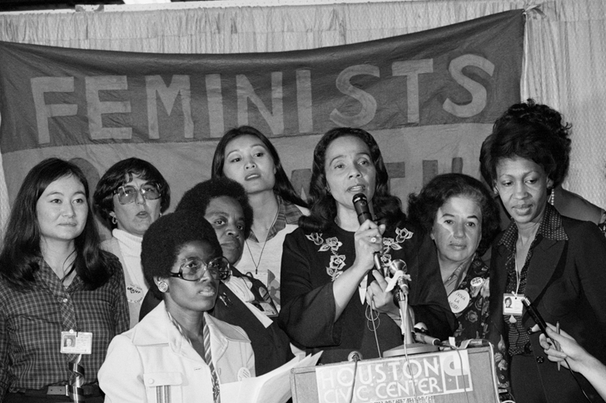
An Era of Change (1960-1980)
Lesson 2 The Women’s Rights Movement

Slide 2
An Era of Change (1960-1980)
Lesson 2 The Women’s Rights Movement
Learning Objectives
Analyze why a movement to expand women’s political rights arose in the 1960s.
Identify the goals and methods that political organizations used to promote women’s rights.
Assess the impact of the women’s movement on American society.

Slide 3
An Era of Change (1960-1980)
Lesson 2 The Women’s Rights Movement
Key Terms
feminism
Betty Friedan
National Organization for Women (NOW)
Equal Rights Amendment (ERA)
Gloria Steinem
Phyllis Schlafly

Slide 4
A New Feminist Movement Pushes for Equality
In the 1960s and 1970s, American women launched a broad-based movement to expand economic opportunities and attain equal rights. The women’s movement fundamentally changed many aspects of American life—from family and education to careers and political issues. Today, the contributions of people of various gender groups continue to shape American culture.

Slide 5
A New Feminist Movement Pushes for Equality
Seeking to Redefine Traditional Roles
Fighting Workplace Discrimination

Slide 6
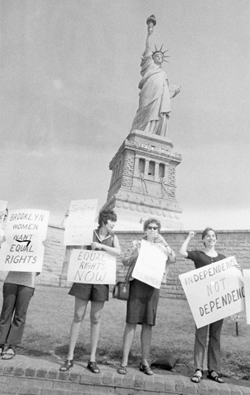
A New Feminist Movement Pushes for Equality
The 1960s and 1970s witnessed a broad-based struggle for equal rights among women in the United States.

Slide 7
The Role of Women’s Civil Rights Organizations
Several years after she wrote The Feminine Mystique, Betty Friedan helped establish the National Organization for Women (NOW). The organization—which dedicated itself to winning “true equality for all women” and to attaining a “full and equal partnership of the sexes”—galvanized the women’s movement.

Slide 8
The Role of Women’s Civil Rights Organizations
NOW Works to Expand Rights Through Lobbying
Feminists Raise Society’s Awareness Through Different Methods
Phyllis Schlafly and Conservatives Oppose the Women’s Movement

Slide 9
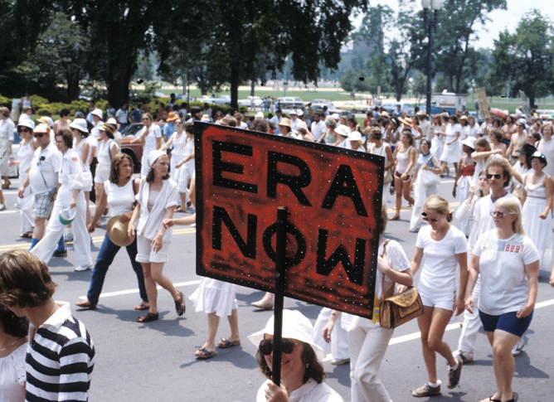
The Role of Women’s Civil Rights Organizations
In 1978, over 100,000 women marched in Washington, D.C., to demand that Congress extend the deadline for ratification of the Equal Rights Amendment.

Slide 10
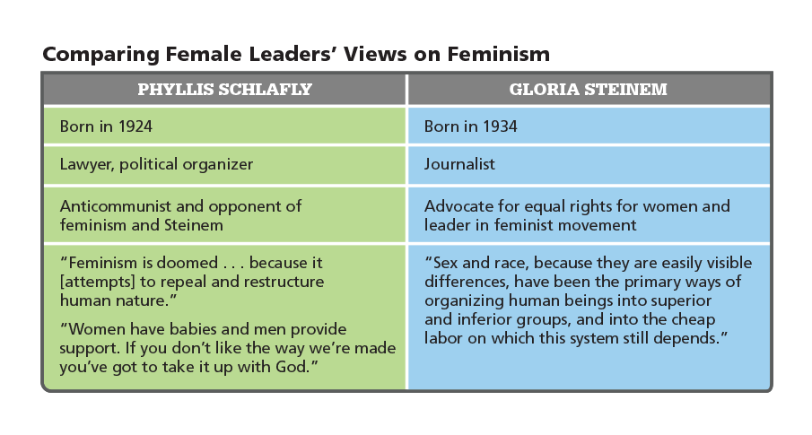
The Role of Women’s Civil Rights Organizations
Analyze Charts How might Schlafly and Steinem respond to a movement that sought expansion of minority women’s employment opportunities?

Slide 11
The Impact of the Women’s Movement
The women’s movement affected all aspects of American society. Women’s roles and opportunities expanded. Women gained legal rights that had been denied them. And feminists sparked an important debate about equality that continues today. Yet the issues they raised continue to divide Americans. Some say that women haven’t made enough gains. Others fear that the movement has actually harmed society.

Slide 12
The Impact of the Women’s Movement
Achieving Equality of Political Rights Through Litigation
Expanding Economic and Employment Opportunities

Slide 13
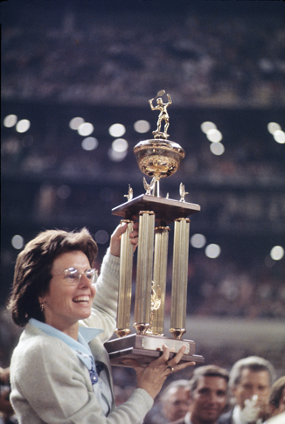
The Impact of the Women’s Movement
The battle for women’s rights took place in many venues. In 1973, tennis player Billie Jean King demonstrated women’s equality with men by defeating Bobby Riggs in The Battle of the Sexes.

Slide 14
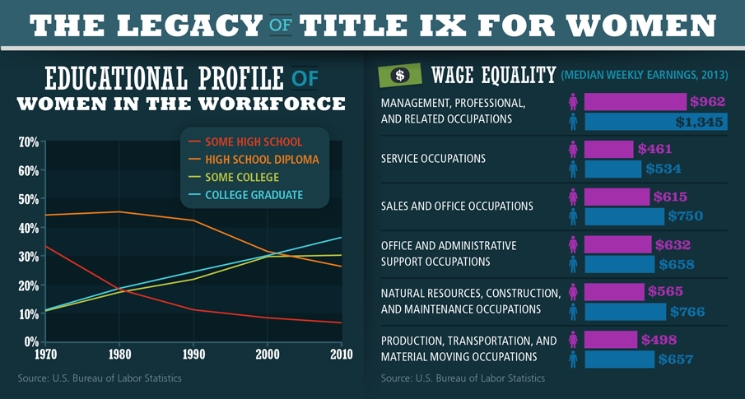
The Impact of the Women’s Movement
Analyze Data What data support the conclusion that the women’s rights reform movement affected women’s opportunities outside the home environment?

Slide 15
Quiz: A New Feminist Movement Pushes for Equality
Which minority rights movement had the greatest influence on the women’s rights movement?
A. youth education rights
B. immigrant housing rights
C. African American civil rights
D. Mexican American farmers’ rights

Slide 16
Quiz: The Role of Women’s Civil Rights Organizations
Gloria Steinem entitled her magazine Ms. in order to
A. protest the Miss America Pageant.
B. challenge the stereotypes in The Feminine Mystique.
C. protest identifying women by their marital status.
D. challenge the humiliating treatment of Playboy bunnies.

Slide 17
Quiz: The Impact of the Women’s Movement
To what does the “glass ceiling” refer?
A. the unavailability of higher education for women
B. the political shortcomings of the women’s rights movement
C. the restrictions on women’s advancement in the workplace
D. the ability for women to engage in every facet of politics except the vote

